Slide 1

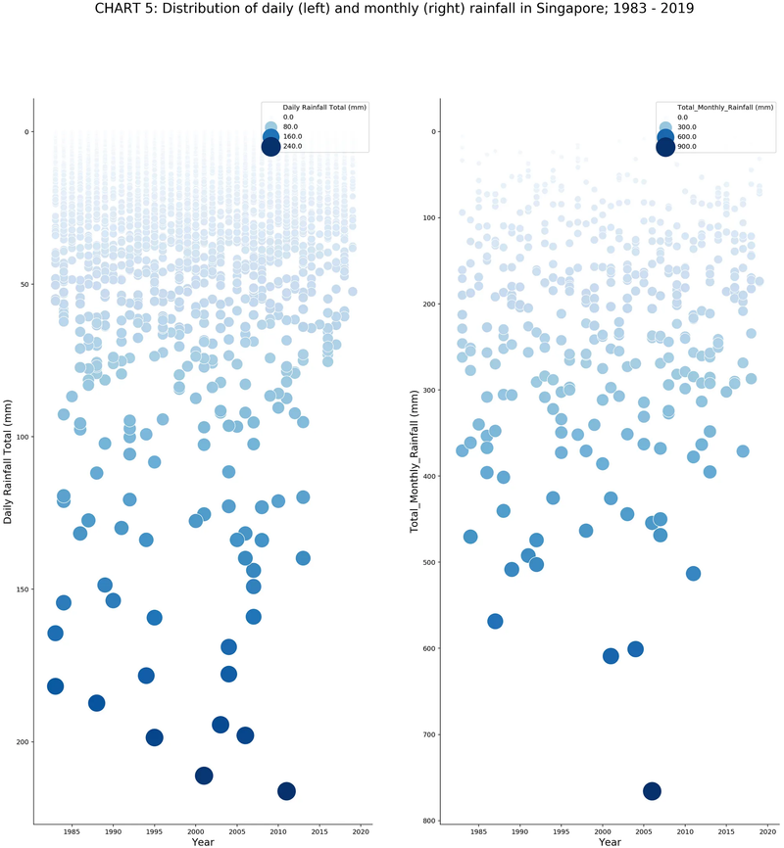
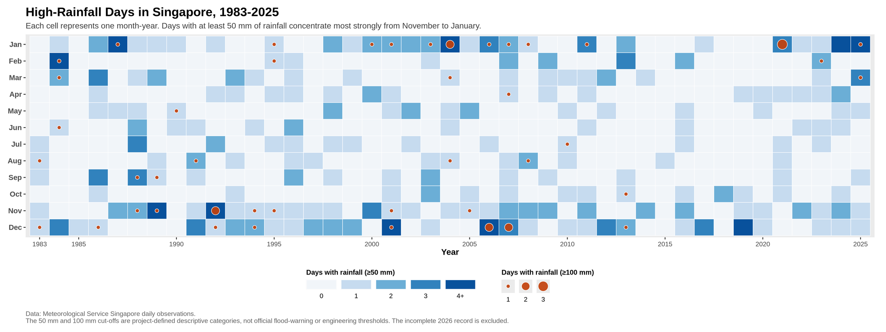
Heavy Rainfall Signals in Singapore (1983-2025)
TEAM CORAL
2403348 - Kieran Sim
2401305 - James Yu
2401401 - Valerie Seow
2403355 - Yip Wei Yang
2403359 - Ethan Ng
Redesigning Rainfall Data For Urban Drainage Planning
INTRODUCTION
ORIGINAL VISUALISATION
REDESIGNED VISUALISATION
The original rainfall chart uses daily and monthly scatterplots to show Singapore’s rainfall patterns from 1983 - 2019. While its unique “falling rain” style is the main focus of the original visualisation and is visually memorable, dense overlapping points and the reversed y-axis make patterns harder to read. Our redesign aims to make heavy rain periods easier to identify for planning and public understanding.
DESIGN BRIEF
This redesign is intended for urban planners, environmental agencies and policymakers in Singapore. The goal is to identify when heavy rain and extreme rain periods occur across months and years, so rainfall timing can be considered in drainage planning, flood-prevention discussions and public communication.
Main revisions:
Removed daily rainfall plot and redesigned to a heatmap
Use of only 2 different guides to represent key rainfall details
Changed to chronological order for Months and Years axis.
Redesigned to better capture important trends and details for urban planners
Shifting the focus to monthly rainfall trends across the year on a heatmap. Reduction of plotted points, focusing on only relevant rainfall distributions for urban planning.
Encoding of only important features identified from rainfall data (heavy and extreme rainfall days) relevant to urban planning, reduces visual complexity.
Use of standard x and y axis orientations for common interpretation of the plot
The trends for which months have heavy or extreme rainfall are immediately visible for urban planners or environmental agencies
Expansion of plot data from 1983 - 2019 to 1983 - 2025
DATA
Meteorological Service Singapore / data.gov.sg: Daily rainfall observations from Changi station.
Changi rainfall dataset: Daily rainfall totals and derived monthly rainfall summaries.
Period used: 1983 - 2025 complete years. 2026 is excluded because the year is incomplete.
Original article: Visualising Singapore’s Changing Weather Patterns (1983–2019), Chart 5
Scan QR for full citations and references
STRENGTHS & WEAKNESSES OF ORIGINAL PLOT
Strengths
The “falling rain” design is unique and visually memorable and connects well to the rainfall theme.
Large and dark markers help highlight extreme rainfall events and make outliers easy to notice.
Weaknesses
Many points overlap, especially for low rainfall days, making the distribution difficult to read.
Rainfall is encoded multiple times using vertical position, marker size and colour intensity, which adds unnecessary visual complexity.
The reversed y-axis supports the rain theme but it may slow interpretation because higher rainfall appears lower on the chart.
Non-intuitive design for urban planners

